Slide 1
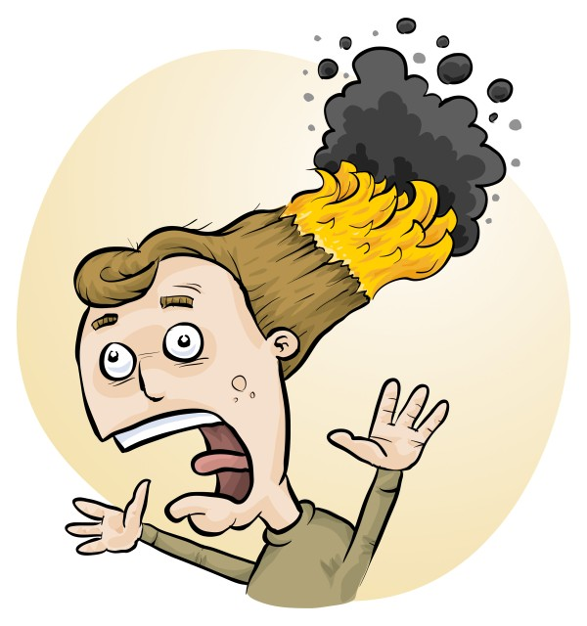
Risks in Primary Science investigations and how to use RiskAssess
Phillip Crisp and Eva Crisp

Slide 2
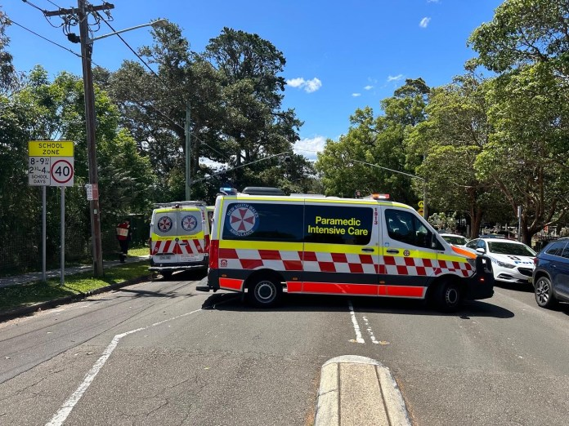
21 November 2022 Manly West Public School
2 students with serious burns
9 students with superficial burns
1 teacher with minor burns
• S Keoghan, M. Muroi and M. Gorrey “’Something had to be up’: Children in hospital as experiment goes wrong” Sydney Morning Herald, 21/11/22.
• “Hazmat incident at Manly West Public School”, Manly Observer, 21/11/22.
• E. Visontay and T. Rose “Children suffer serious burns after outdoor science experiment goes wrong at Sydney school” The Guardian, 21/11/22.

Slide 3
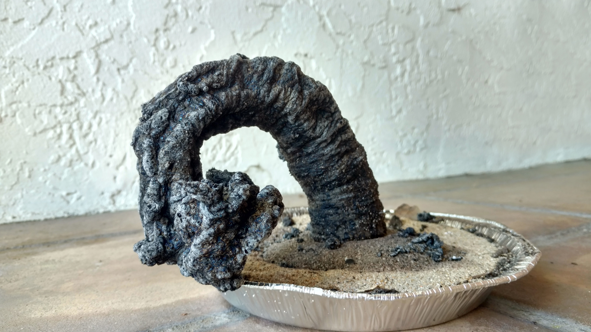
What happened?
Carbon sugar snake
(black snake, sugar snake)
sugar
sodium bicarbonate
methylated spirits / lighter fluid
From the limited information in the news reports, apparently:
• Demonstration performed outdoors on a very windy day
• Gust of wind blew burning material onto students
• Suspect a large-scale demonstration (since so many injured)
Further information?

Slide 4
Be aware of the
• chemicals
• equipment
• biological materials
most likely to cause injury
Use reliable sources of safety information
Don’t follow YouTube without further research!
Always try out an experiment beforehand
Carry out risk assessments as required by law
e.g. use Primary School RiskAssess
and introduce control measures, if needed

Slide 5
Chemicals most likely to cause injury
Demonstrations with . . .
• methylated spirits
lighter fluid, petrol, mineral turps
• hot water
• dry ice
Student use of • art materials (texta pens, paint sprays, white out,
tie dyes, glues)
Students eating chemicals (esp. K-2)
e.g. medicines in first-aid box
burns
allergies
poisoning
Food-grade chemicals are usually safe, except for allergies

Slide 6
Equipment most likely to cause injury
Demonstrations with . . .
• hot objects, e.g. hotplate, stove
• sharp objects
Student use of • button batteries (swallowing may be fatal)
• short-circuited batteries
• hot glue guns
• sharp objects
• latex gloves
Students throwing things!

Slide 7
Biological materials most likely to cause injury
Extreme allergic reactions to foods:
• peanuts, peanut oil, peanut products
• tree nuts
• shellfish and crustaceans (including sea monkeys)
and, less commonly, to
eggs, milk, wheat, soy, fish, sesame, . . . .
Allergic reactions to plant materials, including:
• rhus (leaves, stems)
• London plane tree (trichomes)
• pollens and moulds
Animal bites, stings and parasites
e.g. ticks, leeches, bees, pet animals, snails+slugs

Slide 8
Cleaning chemicals (should be kept away from students!)
• bleach
dishwashing powder, caustic soda (for drains)
ammonia-based cleaners
oven sprays, often strongly alkaline
solvents, many highly flammable and/or toxic
graffiti remover
methylated spirits
Major risks are
highly alkaline materials, e.g. dishwashing powder in eye
allergic reactions
Primary schools may have cleaning materials in classrooms

Slide 9
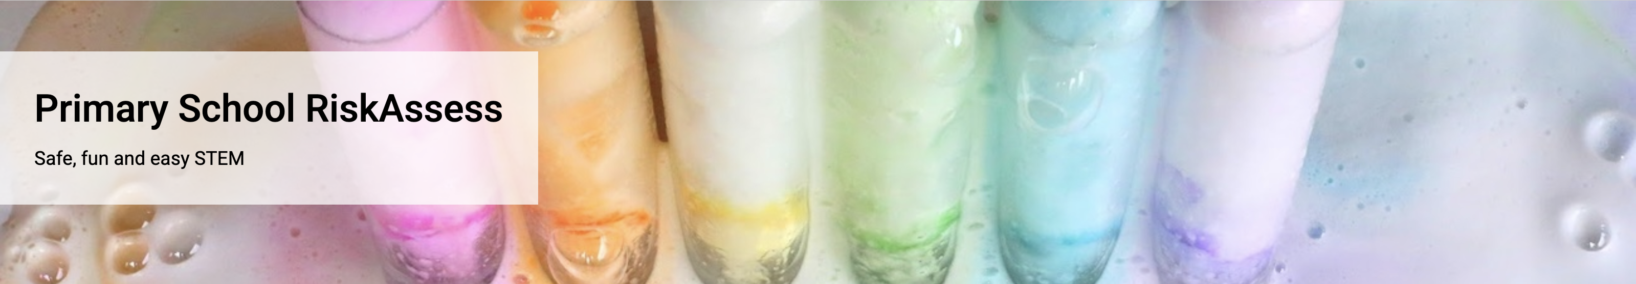
Helps with
advice on potential hazards: chemicals, equipment, biological including allergies
risk assessments, as required by law

Slide 10
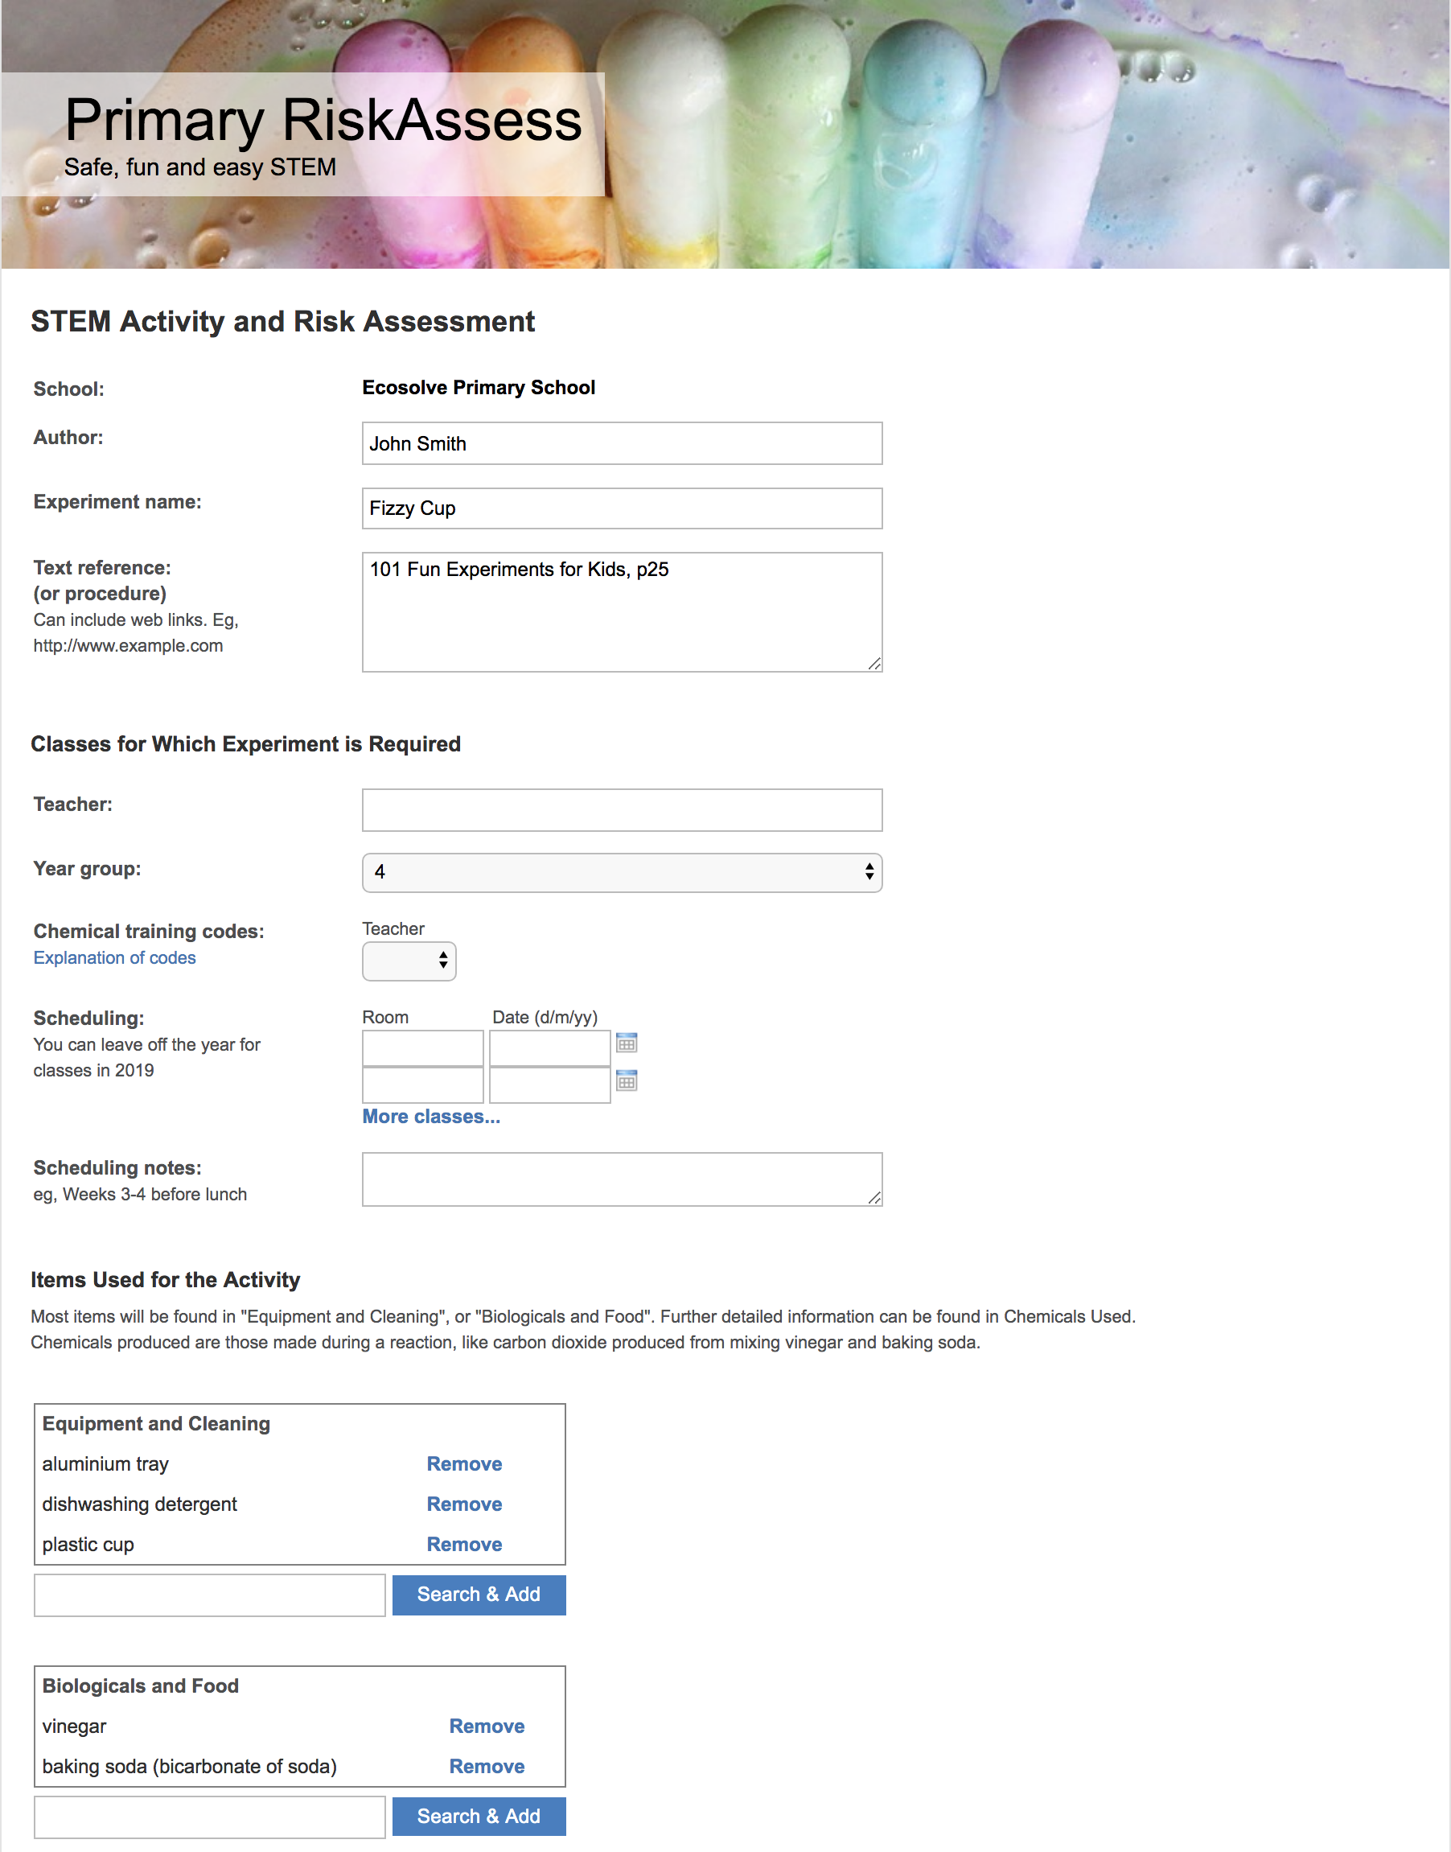
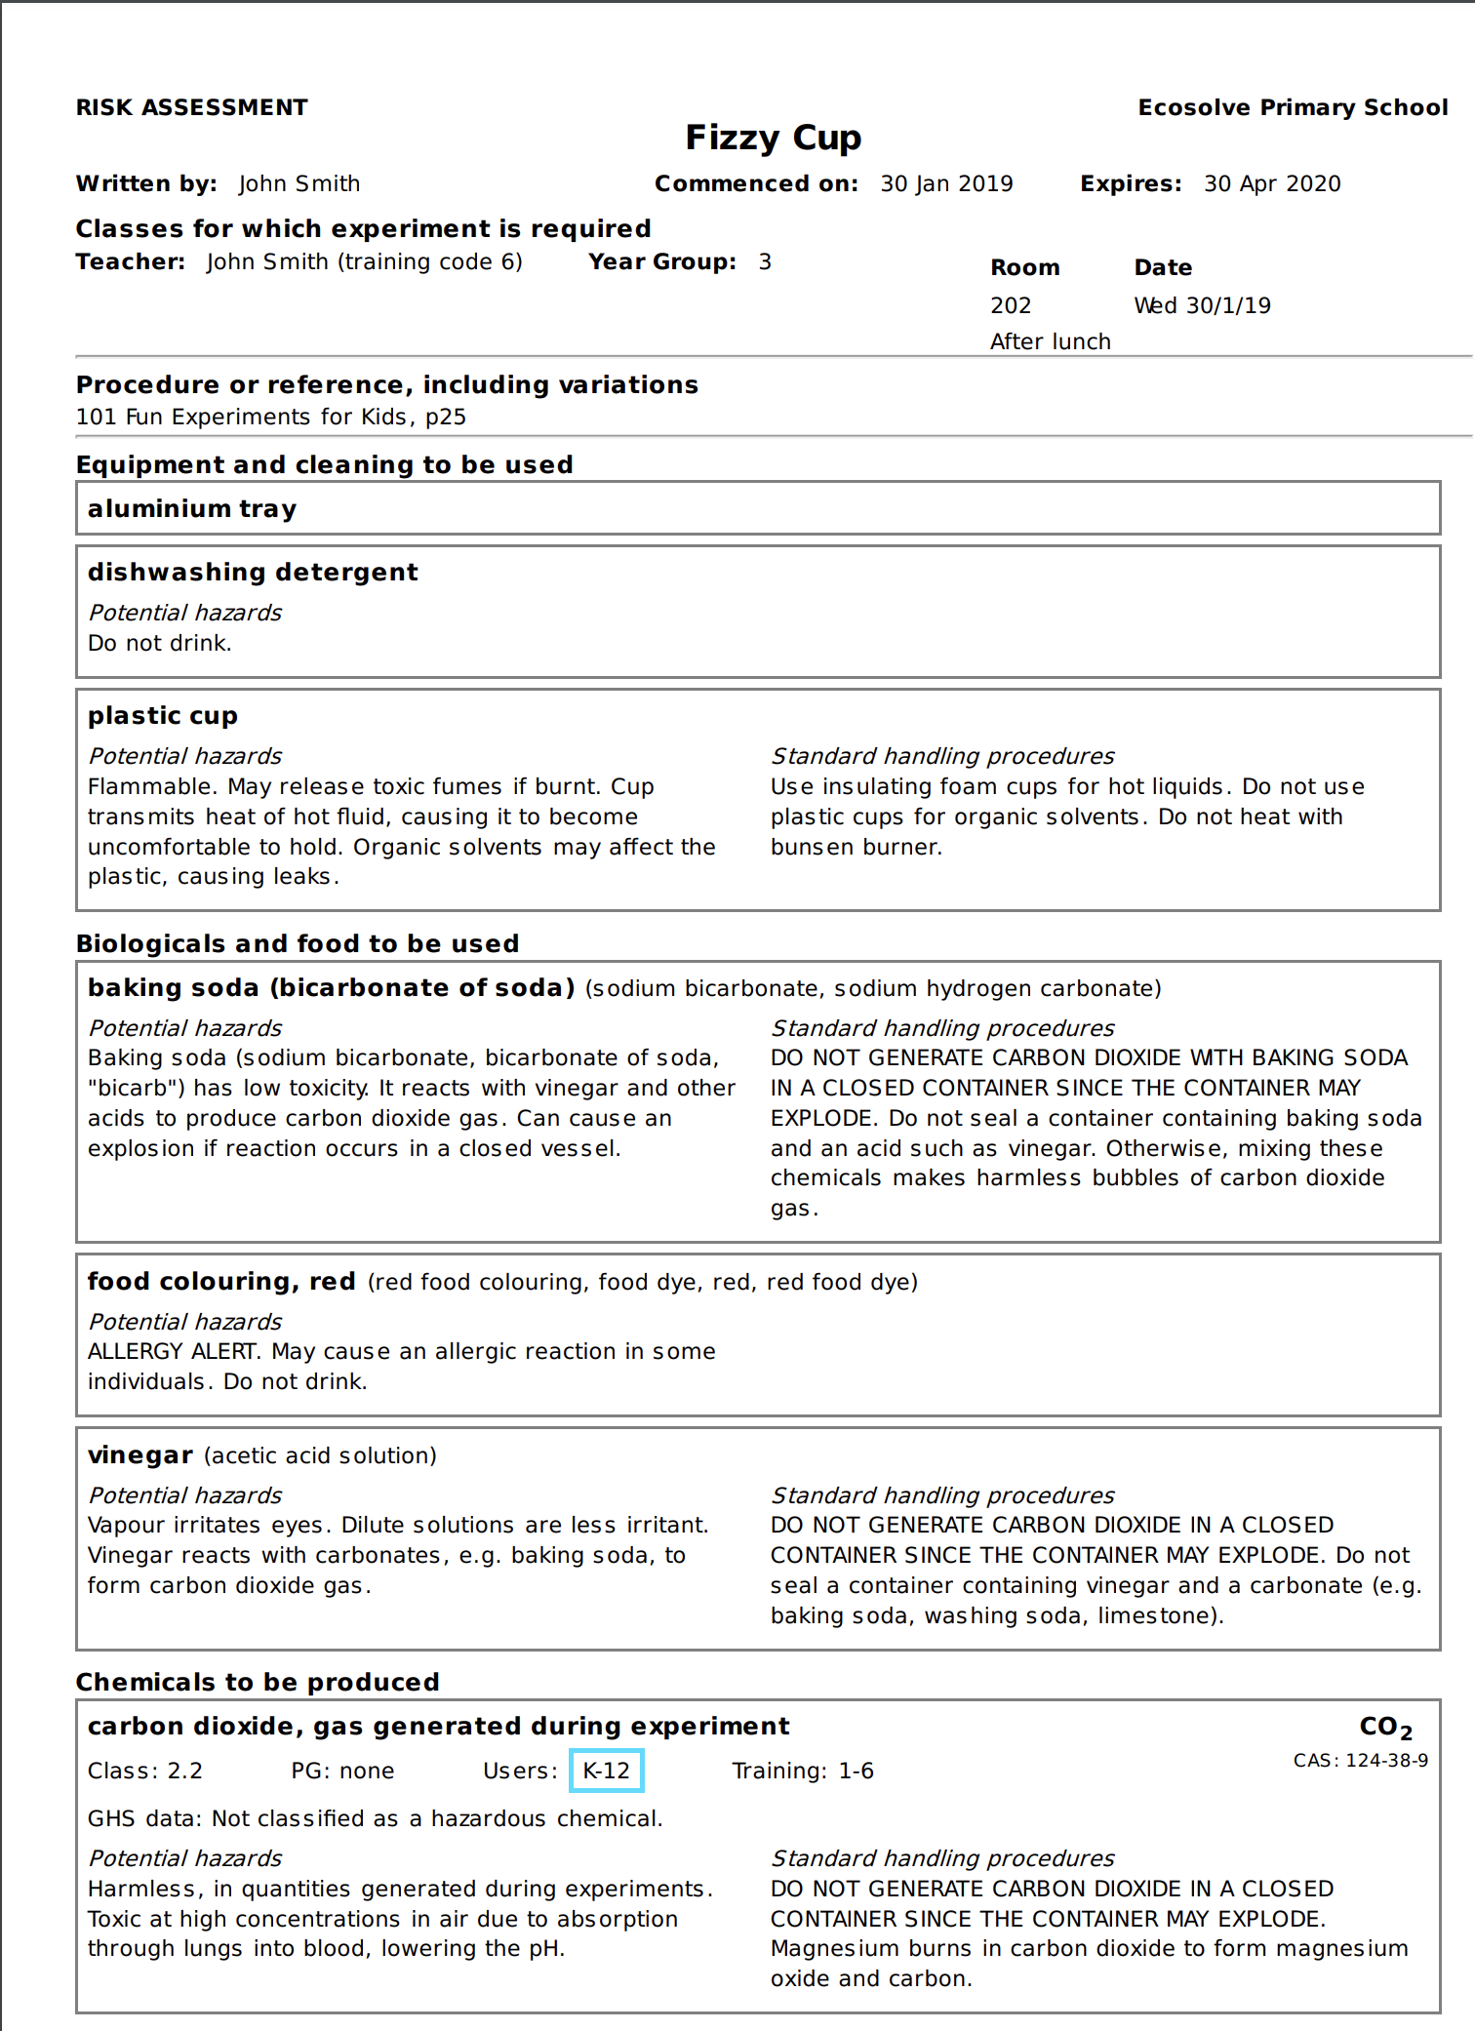

Slide 11
Primary School RiskAssess
Safety information and risk assessment system
Web based, easy and fast to use
Designed for Primary use
Quickly find, share and re-use risk assessments
Minimal paperwork

Slide 12
How to use Primary School RiskAssess
Video: Getting started with Primary RiskAssess
https://www.youtube.com/watch?v=O0WJp30fTDw
Video: Why Assess the Risks of Primary STEM Activities
https://youtu.be/g6V4aPBaZds
Website:
https://www.riskassess.com.au/info/primary_about
This presentation is available in Learning Resources at:
https://www.riskassess.com.au/info/learning_resources

